Slide 1

PRESENTATION ON :
STUDENT MANAGEMENT SYSTEM
PRESENTED BY
Name: Israt Jahan Eva
Id: 20232006010
Name: Amena Akter
Id: 20232008010
Name : Eshita Akter
Id: 20232013010
1

Slide 2
Introduction
The Student Management System application is a digital tool made to make university work easier. It helps manage students, exams, subjects, and notices in one place with a simple, user-friendly design. It saves time and keeps everything organized.
2

Slide 3
Objective
• Our system helps manage student data easily.
• It reduces manual work and paperwork.
• Users can get quick and accurate updates.
• Next, let’s see an introduction to the system.
3

Slide 4

Methodology
System Design: The project is divided into modules: Dashboard, Add Student, Add Subject, Exam Schedule, and Notice Board.
Frontend: HTML, CSS, JavaScript, and PHP were used to make a responsive and interactive interface.
Backend: PHP and MySQL (or another backend) manage the database, authentication, and data storage.
Testing & Deployment: Each module was tested separately before joining them to ensure everything works correctly
CSS
JavaScript
4

Slide 5
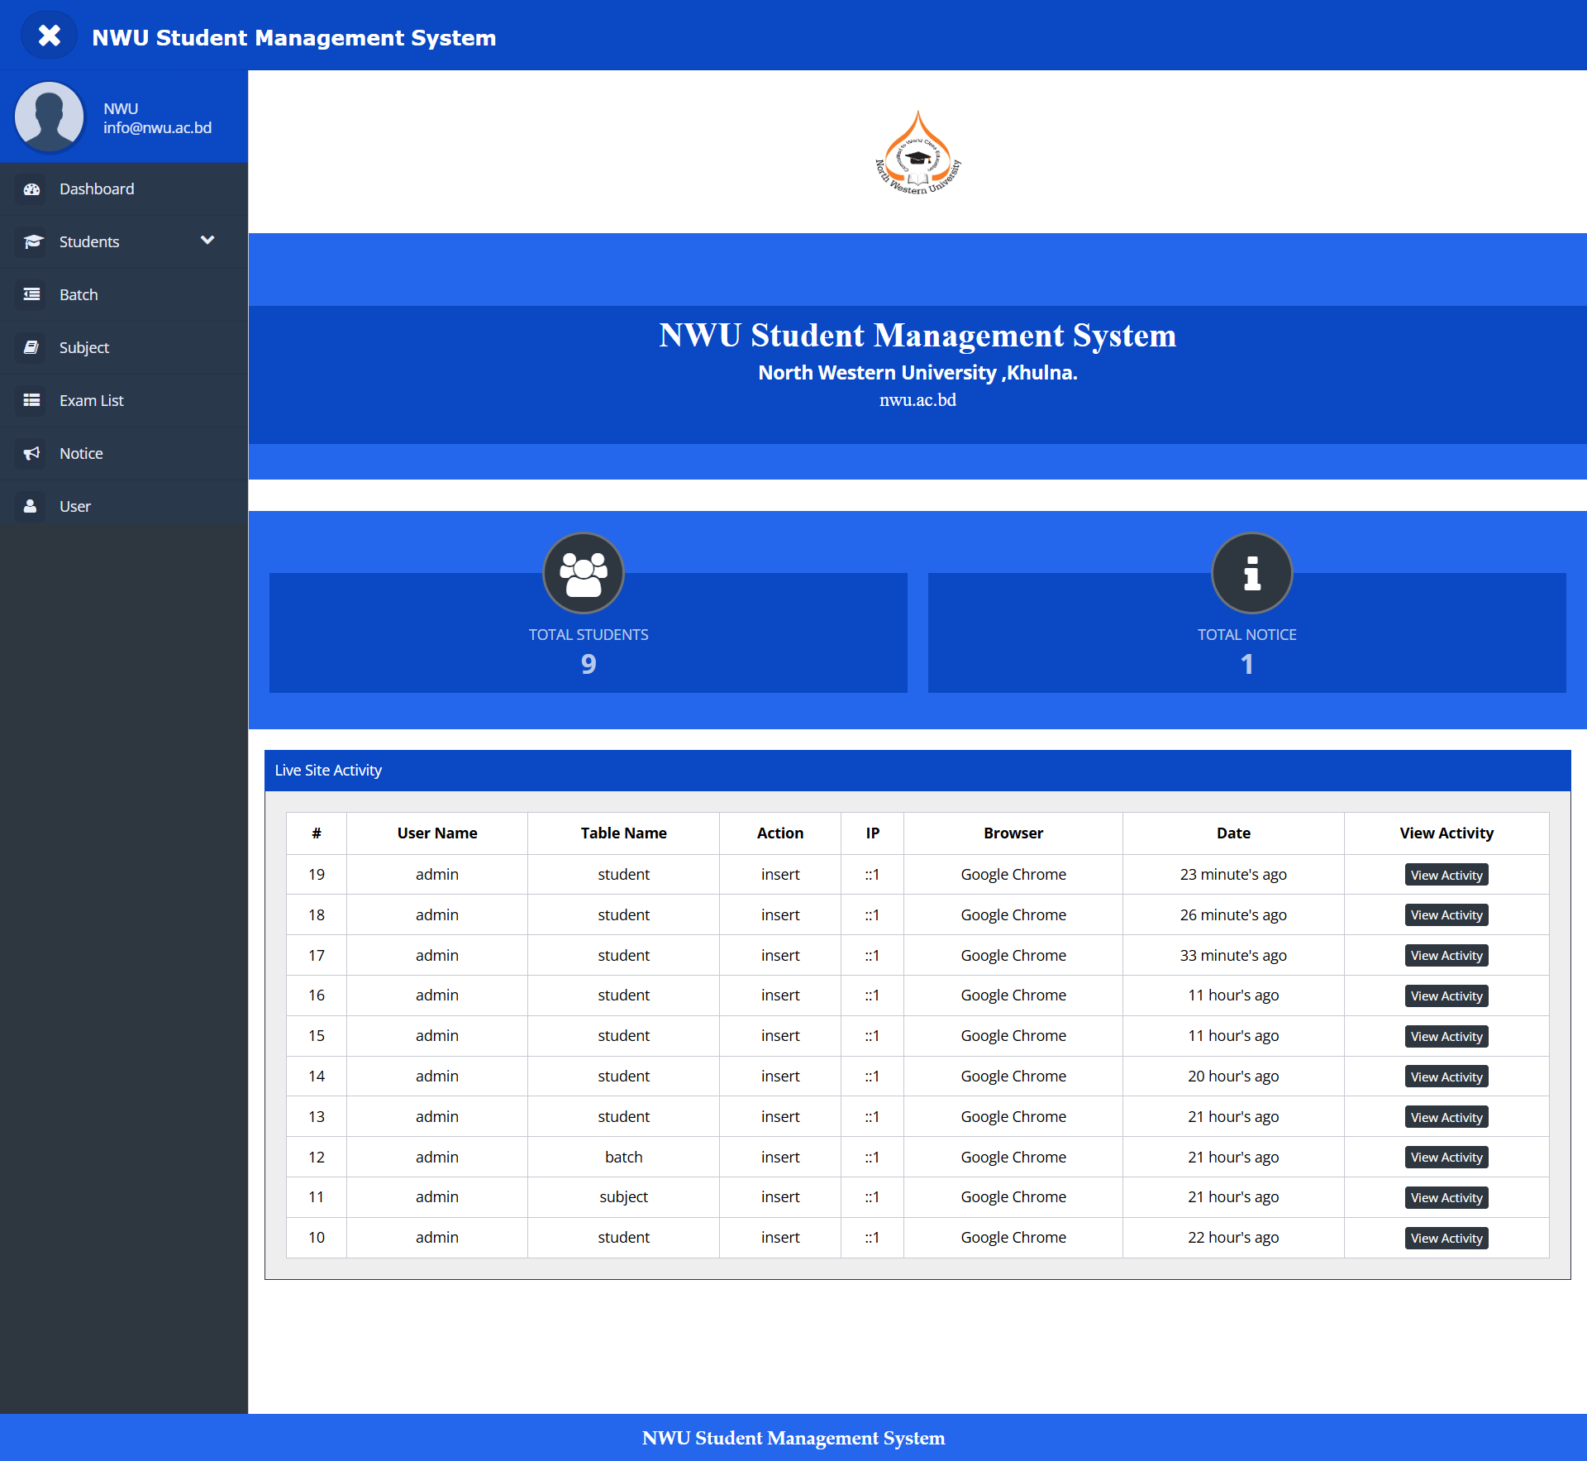
Home Page (Dashboard)
•This is the main dashboard of the Share Link application. It serves as the central hub for users, displaying key metrics and navigation options.
5

Slide 6
Sidebar / Menu
•The sidebar or menu provides easy navigation to different modules such as Add Student, Exam Schedule, Notice Board, and Add Subject.
6

Slide 7
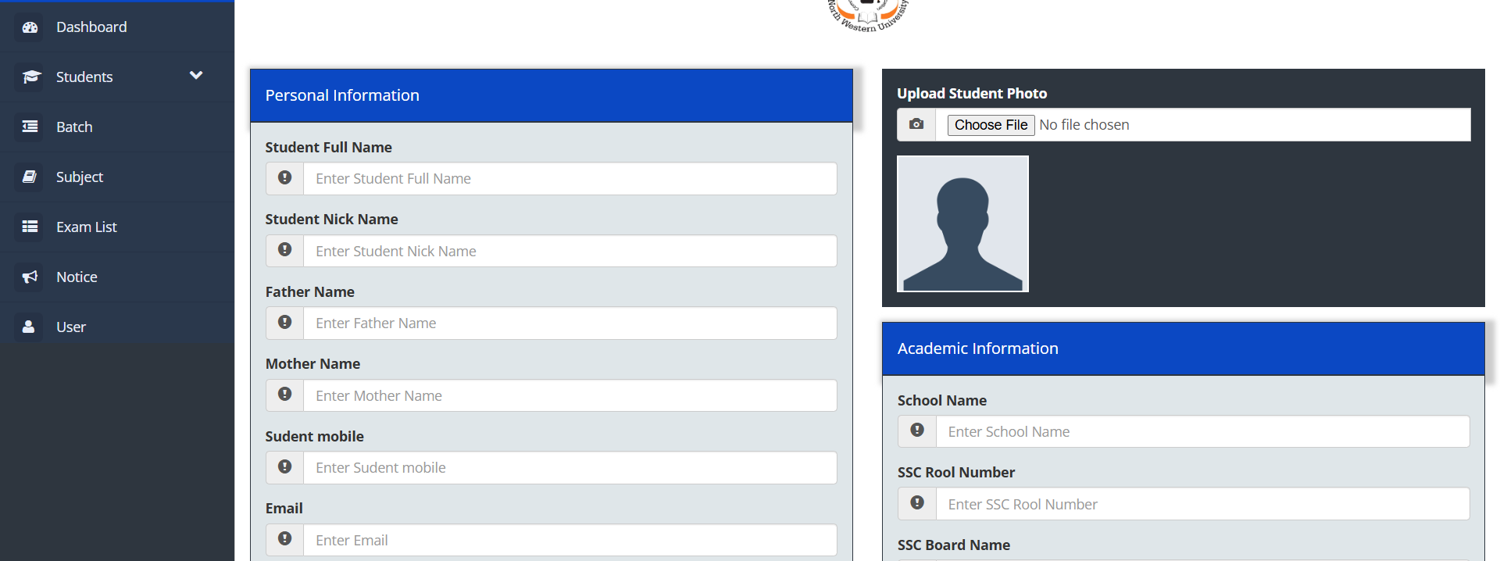
Student Page
•This page allows administrators or teachers to add new student details to the database. It includes fields for name, ID, class, and contact information.
7

Slide 8
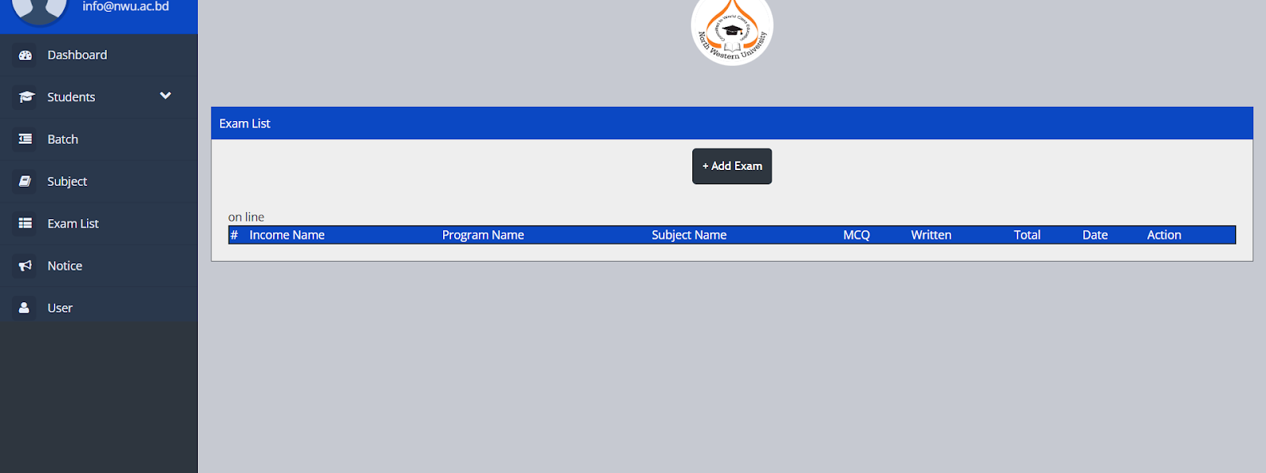
Exam Schedule Page
•This page displays and manages exam schedules. Users can add, update, or delete exam information for various subjects and classes.
8

Slide 9
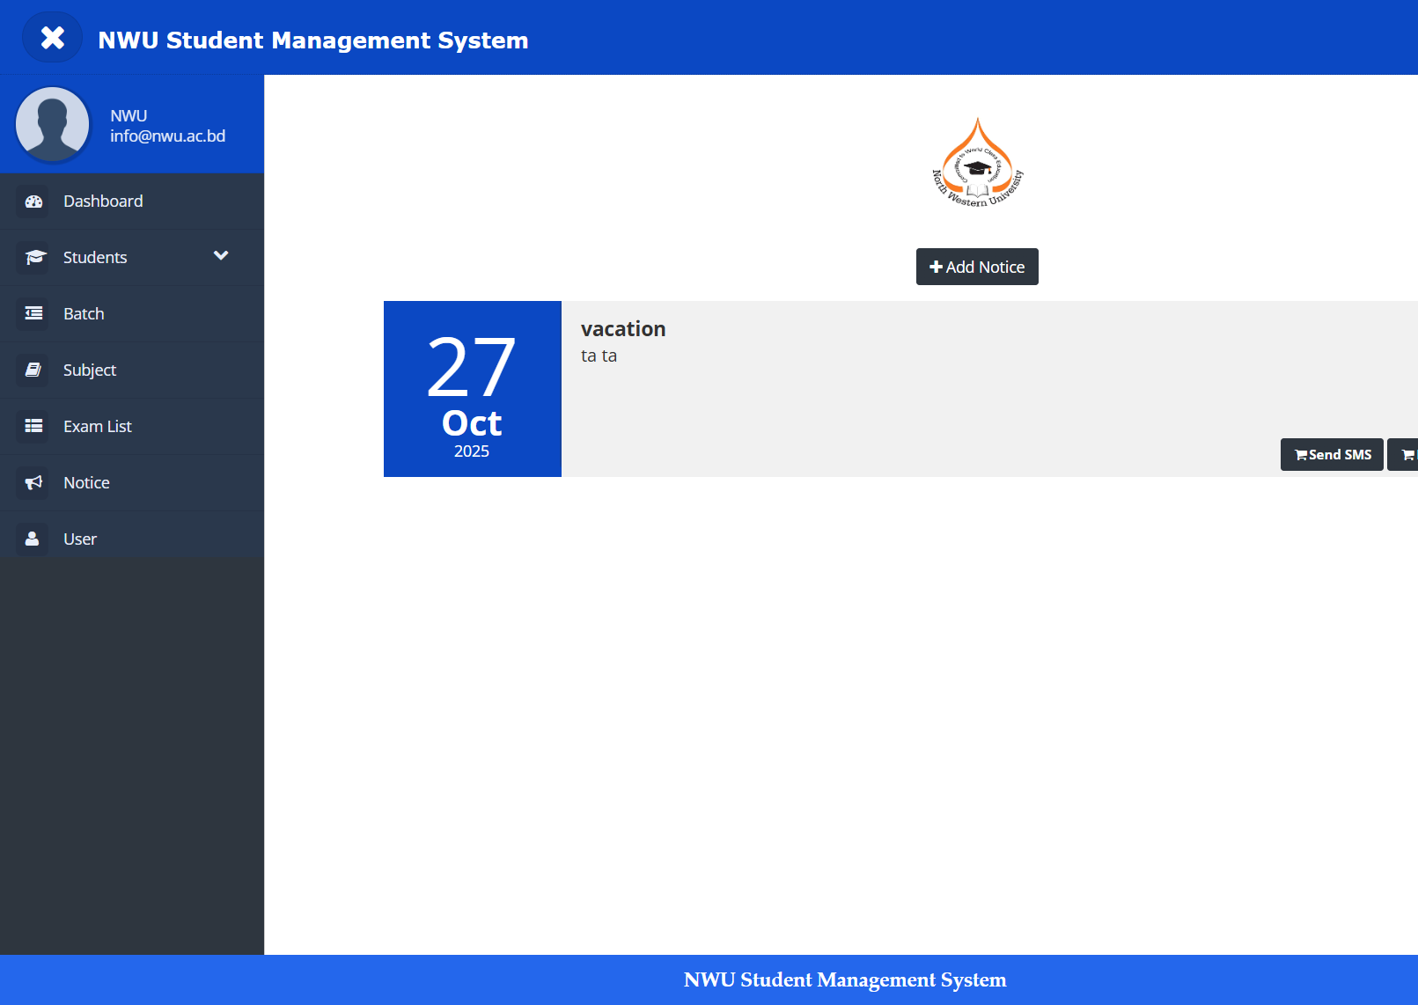
Notice Page
•The notice page shows important announcements for students and staff. It helps keep everyone updated with the latest information.
9

Slide 10
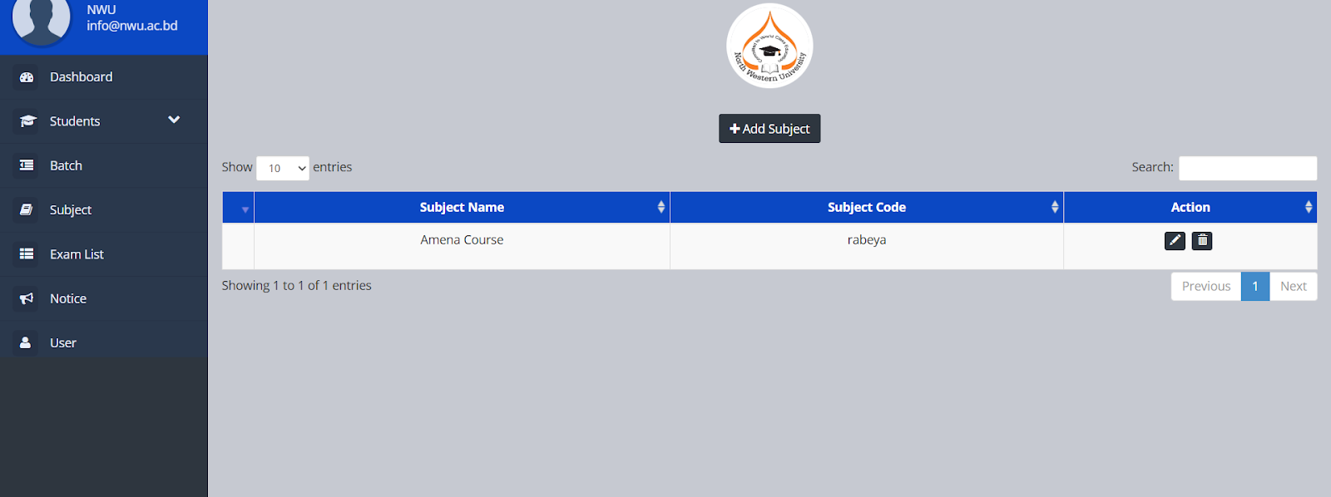
Subject Page
•This module enables adding and managing subjects offered in the system. Users can specify subject codes, titles, and related information.
10

Slide 11
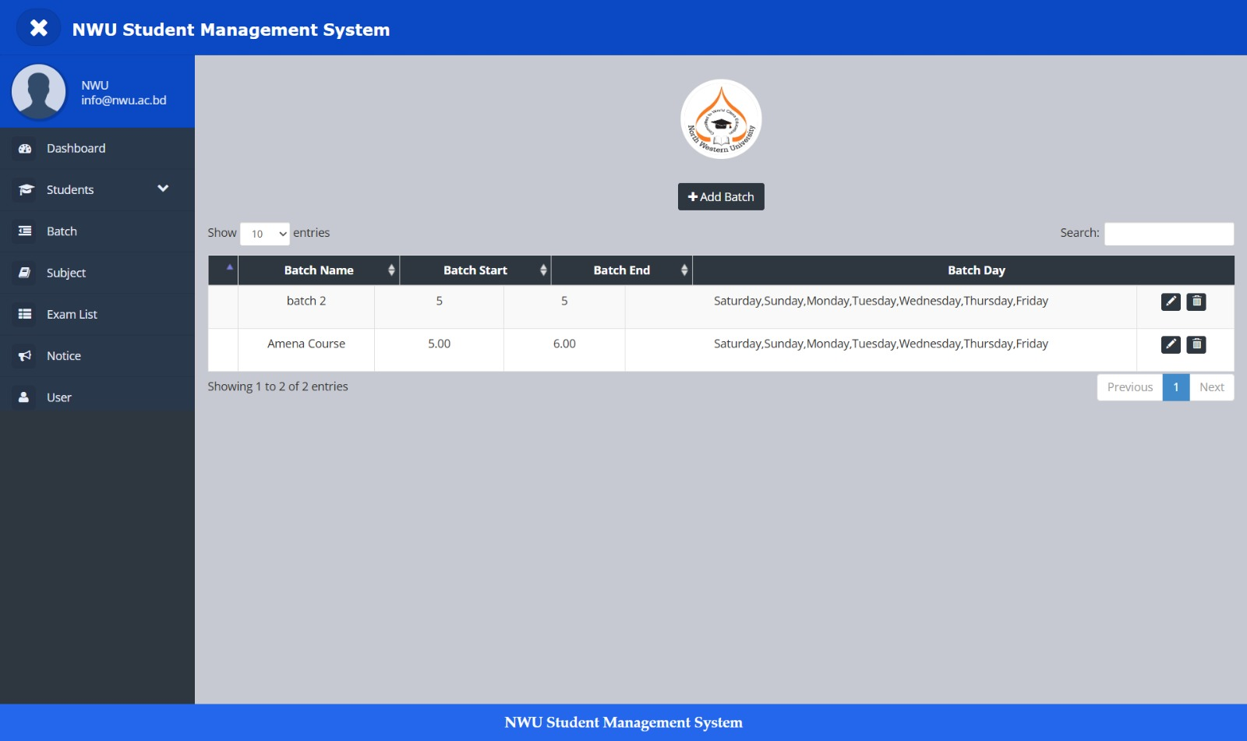
Batch Page
This page helps the teacher add and manage course batches. It shows batch time and days clearly, making student schedule management easier.
11

Slide 12

Conclusion
This Student Management App helps both teachers and students. Teacher can easily manage students, batches, subjects, exams, and notices. Students can get updates, view schedules, and stay connected. It makes the whole system simple and well organized.
12

Slide 13


